Slide 1



MARATHON ASSET MANAGEMENT
CORNELL CFEM CAPSTONE 2026
Marathon Project Meeting
Revisiting Data Cleaning Incorporating LLM
SPONSOR: Jason Foster
ADVISOR: Sasha Stoikov
TEAM: Alex Lee, Max Yap, Minxi Lin, Yung Lee, Olivia Mei
DATE: October 1, 2026

Slide 2


Preprocessing
MARATHON ASSET MANAGEMENT
One change to the share filter
CORNELL CFEM CAPSTONE 2026
Step | Meeting 2 | Now
Raw parsed rows | 771,544 | 771,544
Restrict to 2023Q1 onward | 742,986 | 742,986
Drop share-denominated rows | 667,273 | 680,296
Drop “amounts_only” rows | 595,657 | 608,680
Meeting 2 rule
Drop every row with a share count (InvestmentOwnedBalanceShares not NA)
Current rule
Also keep share-tagged rows when they report rate terms and amounts together (context_type = “mixed”).
Rows remaining after each step; the other two steps are unchanged.
+13,023 rows across 750 filer-quarters

Slide 3
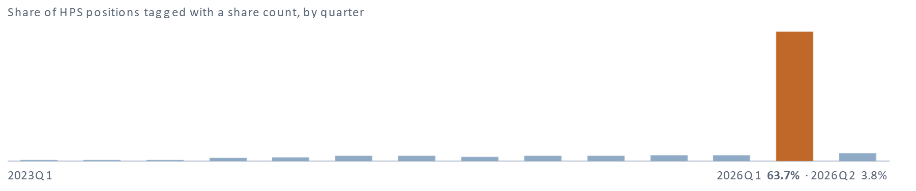
Preprocessing | Case
MARATHON ASSET MANAGEMENT
HPS Corporate Lending Fund, 2026Q1
CORNELL CFEM CAPSTONE 2026
63.7%
of positions tagged with a share count (696 out of 1,092), compared to 0–3.8% in its other 13 quarters
539
of them are term loans with a real rate or spread, cost and fair value
$26.1B
fund fair value kept; Meeting 2 rule only leaves $5.6B, a drop of 79% from 2025Q4

Slide 4
Rate Imputation | Foundation
MARATHON ASSET MANAGEMENT
Built on the 2025 final report’s two identities
CORNELL CFEM CAPSTONE 2026
Identity 1 – takes precedence
IR = PIC + PIK
Checked whenever PIC or PIK is present
Identity 2
IR ≈ base + spread
Used where identity 1 cannot be checked
Priority when fields are missing or disagree:

Slide 5
Rate Imputation | The Report’s Rules
MARATHON ASSET MANAGEMENT
Built on the 2025 final report’s two identities
CORNELL CFEM CAPSTONE 2026
2025 report rule | In the current code
Rescale rates (/100 or /10,000), fix signs | Kept
Missing coupon = spread + SOFR | Kept and extended: each currency's base, floors, Prime
2.1 rate > PIK → PIC = rate − PIK | Kept · fills 43,913 rows
2.2 rate < PIK → PIC = rate, IR = rate + PIK | Kept · fixes 1,223 rows
3.2 rate > PIC → spread = PIC, PIC = rate | Kept when rate − PIC ≈ base rate (±50bp) · fixes 1,514 of 1,558 cand.
3.3 rate < PIC → spread = rate, IR = PIC | Kept · fixes 4,066 rows
1 lone rate in the spread range → spread | Not adopted: mostly money-market funds and fixed bonds at 4–7%
2.3 rate < PIK, sum implausible | Not needed: no such rows

Slide 6
Rate Imputation | Upgrades
MARATHON ASSET MANAGEMENT
CORNELL CFEM CAPSTONE 2026
Rules Added
Added rule | What it catches | Rows | Without it
rate_is_spread_floating | Floating loan, spread = IR: the value is the spread | 259 | +234 identity-2 failures
rate_is_spread_untagged | Untagged loan, spread = IR at 2–9%: a spread | 498 | +463 identity-2 failures
clear_spread_untagged_coupon | Untagged loan, spread = IR above 9%: the coupon | 445 | +320 identity-2 failures
fixed_spread_is_rate | Fixed loan with only a “spread” | 3 | 3 loans with no rate
spread_is_allin_rate | Spread = PIC + PIK: spread field holds the coupon | 1,164 | +80 identity-1 failures
rate_below_spread_replaced | IR below the spread: IR held a floor or base | 498 | +205 identity-2 failures
rate_from_base_plus_spread_plus_pik | PIK paid on top of base + spread | 674 | +445 IR > 2pp below base + spread
pic_from_rate_minus_pik_reconcile | All three reported, IR ≠ PIC + PIK | 1,541 | +1,541 identity-1 failures
rate_is_spread_components_exceed | PIC + PIK above IR: IR held the spread | 18 | 11 rows with IR < PIK
rate_is_cash_part_of_base_plus_spread | IR + PIK ≈ base + spread (±50bp): IR is only the cash part | 3,973 | +3,032 IR > 2pp below base + spread
fix_component_scale | PIK tagged in percent (0.50 = 0.50%) | 14 | 6 negative coupons
Base rate · currency, floor, Prime | 14 currencies, 0% floor, reported floors, Prime | 87,556 | Non-USD loans get no rate
“≈” within 50bp · identity 1 fails beyond 1bp, identity 2 beyond 2pp

Slide 7
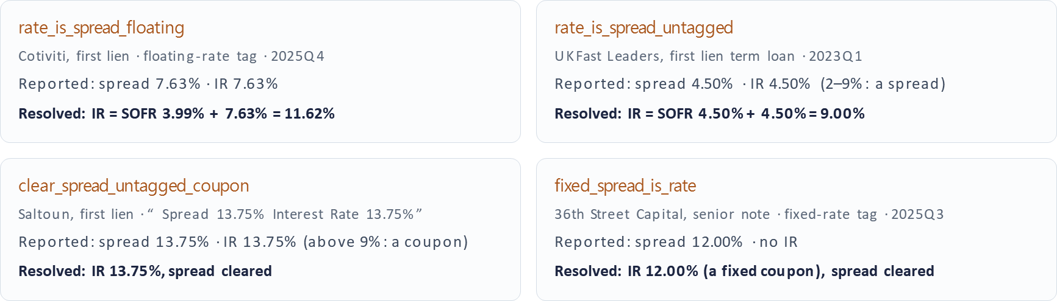
Examples | Handling Spread = IR
MARATHON ASSET MANAGEMENT
CORNELL CFEM CAPSTONE 2026
Is the number a spread of a coupon?

Slide 8
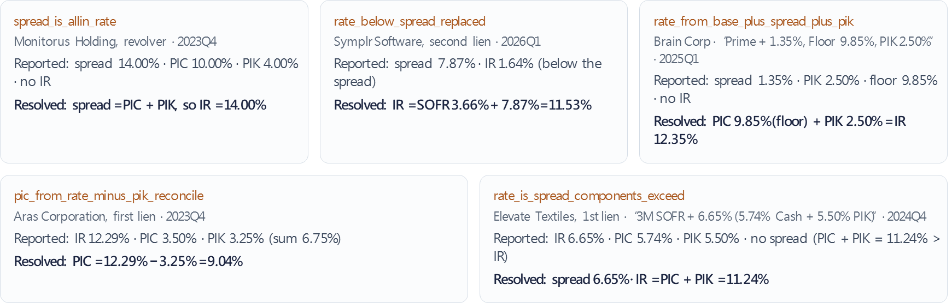
Examples | Handling Wrong Placeholder
MARATHON ASSET MANAGEMENT
CORNELL CFEM CAPSTONE 2026
Moving values back until the identities hold

Slide 9
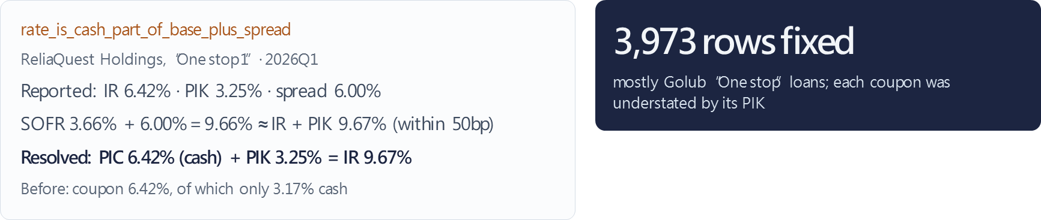
Examples | Handling Identities Mismatch
MARATHON ASSET MANAGEMENT
CORNELL CFEM CAPSTONE 2026
IR reported as the cash part only

Slide 10
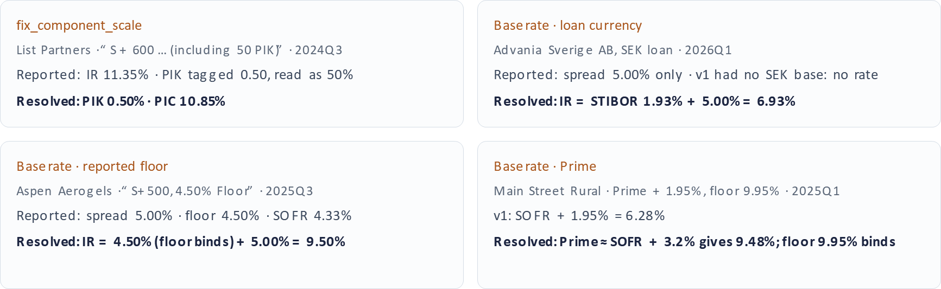
Examples | Handling Units and Base Rates
MARATHON ASSET MANAGEMENT
CORNELL CFEM CAPSTONE 2026
Choosing reasonable scale and benchmark

Slide 11
MARATHON ASSET MANAGEMENT
CORNELL CFEM CAPSTONE 2026
Data cleaning result for rates imputation
Rate check (each row counted once) | v1 | Final
No interest rate | 26,414 (5.29%) | 0
Negative IR, PIC or PIK | 526 (0.11%) | 0
Identity 1 off by > 1bp | 706 (0.14%) | 339 (0.07%)
of which identity 2 also off by > 2pp | 641 | 0
Identity 2 off by > 2pp (spread only) | 9,075 (1.82%) | 4,787 (0.96%)
Pass every check | 462,278 (92.64%) | 491,376 (98.97%)
Total: rows that should carry a coupon | 498,999 | 496,502
IR < PIK: 1,231 rows in v1, 0 final. Final total = 502,299 rows less 5,797 zero-rate rows (unfunded revolvers, “—%”).

Slide 12
MARATHON ASSET MANAGEMENT
CORNELL CFEM CAPSTONE 2026
Borrower Name Cleaning
Problem (Benchmark: 4,460 manually corrected borrower names checked by opus 5.5)
Error category | Count | Share | Problem | Example (Borrower Name / Incorrect / Correct)
Row shift | 3,038 | 68.1% | Output for one borrower was assigned to another row | Row A receives Row B’s prediction
Fund vehicle instead of borrower | 1,053 | 23.6% | Model selected a JV, SPV or reporting vehicle | Emerald JV LP, CP Atlas Buyer, Inc. / Emerald JV LP / CP Atlas Buyer, Inc.
No-borrower placeholder | 171 | 3.8% | Model returned null/placeholder despite an identifiable borrower | ... Media Encore Investment Type… / [Null] / Encore
Fund vehicle appended | 147 | 3.3% | Borrower was retained together with an unrelated fund vehicle | CDK Global Inc., Verdelite JV LP / CDK Global Inc., Verdelite JV LP / CDK Global Inc.
Industry prefix glued | 51 | 1.1% | Industry label remained attached to the borrower name | Media Associa Associations Inc… / Media Associa Associations Inc. / Associa Associations Inc.
Total | 4,460 | 100.0%

Slide 13
MARATHON ASSET MANAGEMENT
CORNELL CFEM CAPSTONE 2026
Borrower Name Cleaning
Model: GPT-4.1-mini
Pipeline Improvement:
  Original: Raw names → LLM → Positional parsing → Final output
  Current:
Stage | What V2 does | Output
Source isolation | Processes one source row per request and assigns a stable custom_id | Prevents cross-row assignment
Pre-clean | Removes disclosure labels, industry prefixes and instrument terms from candidate spans | Cleaner borrower candidates
Candidate generation | Detects fund vehicles, borrower fragments and structured-finance IDs | Traceable candidate list
Prompt selection | Applies explicit borrower-selection priorities | Selected borrower
Post-validation | Checks source support, vehicle selection, nulls and confidence | Auto-accept eligibility or review flag

Slide 14
MARATHON ASSET MANAGEMENT
CORNELL CFEM CAPSTONE 2026
Borrower Name Cleaning
Recovery by Error Category
Error category | Original errors | Fixed | Remaining | Recovery rate
Row shift / cross-row assignment | 3,038 | 2,901 | 137 | 95.5%
Fund vehicle instead of borrower | 1,053 | 1,000 | 53 | 95.0%
No-borrower placeholder | 171 | 144 | 27 | 84.2%
Fund vehicle appended | 147 | 141 | 6 | 95.9%
Industry prefix glued | 51 | 50 | 1 | 98.0%
Total | 4,460 | 4,236 | 224 | 95.0%

Slide 15
Sector & seniority
MARATHON ASSET MANAGEMENT
CORNELL CFEM CAPSTONE 2026
Classification across 14 quarters
608,680 source records, from 2023Q1 to 2026Q2
Component | Method and output
Sector | Team rules and saved LLM answers
Seniority | Old label plus revised text-rule candidates
Separate fields | Lien rank and loan structure
Traceability | Original text, source keys and change reasons
Holding-level records. Borrower identities remain unverified.
Notes:
This week I focused on our sector and seniority classification task. I built on the team's existing rules and saved LLM results, and moved the workflow beyond the development examples. I first ran Q2, checked the output, and then ran all fourteen quarters. The full source table contains about six hundred and nine thousand records.
For sector, I kept the existing ten categories. The original rules still take priority. If a rule cannot classify a record, the workflow can reuse a saved LLM answer when the full original description matches exactly and the score meets the team's existing threshold. I did not merge companies with similar names.
For seniority, I kept the old label and added a separate candidate, together with the words that triggered it. I also kept lien rank separate from loan structure. For example, One Stop can describe the structure even when the text does not tell us the lien rank.
The output preserves the original description and source links. These are holding-level records, not unique borrowers. It also marks which records belong to the smaller numeric-cleaned table, so we can keep the two sample definitions separate.
中文提示（不朗读）
这页讲本周工作的范围和方法：沿用团队规则与旧LLM结果，先Q2后全期；seniority、lien和structure分开。记录数不是公司数，也没有做borrower合并。
Source
/Users/olivia/Desktop/FE project_Technology/03_Research_研究/Risk_by_Sector/runs/2026-09-30_LLM_S1S2_offline_batch_v1/results/full/summary.json: cohorts raw_full and numeric_full; policy/EXECUTION_POLICY.txt; code/batch_classify.py. Full input SHA256 8f0de8093d21988336848f99ace9f61a3226c4a8e6f322edbe1c96290e548ddd.
Meeting: October 1, 2026. All figures describe development candidates, not validated risk conclusions.

Slide 16
Sector & seniority
MARATHON ASSET MANAGEMENT
CORNELL CFEM CAPSTONE 2026
5,397 seniority candidates changed
Comparison with the original team rule on the same 608,680 records
Q2 2026: 588 candidate changes
Candidate changes require semantic review.
Notes:
Across the full source table, the revised text checks produced five thousand, three hundred and ninety-seven changes to the seniority candidate. The chart separates the changes because simply counting more filled labels would miss part of the work.
There were three thousand, one hundred and twenty-five records where an Unknown became a specific candidate. There were also two thousand, two hundred and twenty-nine records where an existing label went back to Unknown. In those cases, the checks found that the original text did not clearly support the old label, or that it needed further review. Another forty-three records changed between specific categories.
The latest quarter is included in these totals. Q2 had five hundred and eighty-eight changes. Within Q2, the three hundred and seventy-nine additions all came from recognizing hyphenated first-lien wording. They span four filing entities, so they should not be described as three hundred and seventy-nine different companies.
These figures count candidate changes. I have not established that every change is correct. The useful output is that we can now see each difference and trace it back to the original text.
中文提示（不朗读）
核心数字只记5,397和Q2的588。补回、撤回、改类要分开讲。379条连字符例子不是本周新发现的独立风险事件，而是旧开发规则的全量应用。
Source
/Users/olivia/Desktop/FE project_Technology/03_Research_研究/Risk_by_Sector/runs/2026-09-30_LLM_S1S2_offline_batch_v1/results/full/summary.json: raw_full seniority_candidate_changes 5397 = 3125 + 2229 + 43; raw_Q2 588 = 379 + 200 + 9. REPORT_阶段一二结果.txt section 3: Q2 hyphen additions across 4 filing CIKs.
Meeting: October 1, 2026. All figures describe development candidates, not validated risk conclusions.

Slide 17
Sector & seniority
MARATHON ASSET MANAGEMENT
CORNELL CFEM CAPSTONE 2026
Text patterns change the rank label
Three Q2 examples explain the candidate changes
Identifier excerpt | Old rank | New candidate
Raptor US Buyer II Corp. “First-lien revolving loan” | Unknown | First lien
Diamond Mezzanine 24 LLC “First lien senior secured loan” | Subordinated / Mezzanine | First lien
First Brands Group, LLC “Junior Secured Loans” | Second lien | Rank unresolved Secured retained
Company words and instrument wording can imply different categories.
Identifier-based candidates. Source and legal-ranking checks remain pending.
Notes:
These examples show why the distinction matters for the project.
The first record is a Raptor loan whose description says First-lien revolving loan. The old rule missed that wording because of the hyphen. The revised check returns a first-lien candidate. This is a formatting issue where the description already contains the information.
The second example is Diamond Mezzanine 24 LLC. Mezzanine appears in the company name, but the same record describes the instrument as a first lien senior secured loan. The old rule returned a subordinated or mezzanine category. The new candidate follows the loan wording. This illustrates why finding a word anywhere in the description can give us the wrong type of information.
The third example says Junior Secured Loans. The old rule treated that as second lien. The wording supports a secured loan, but it does not specify second lien. So the candidate leaves the rank unresolved while retaining secured status. We would need more source evidence to go further.
These decisions could change how a portfolio looks when we compare seniority categories. I have not yet measured their effect on risk metrics. The examples support a classification review, not a conclusion that these borrowers became safer or riskier.
中文提示（不朗读）
不要把3个例子讲成3个信用事件。重点是公司名里的Mezzanine不等于贷款是夹层债；Junior Secured也不能直接等同Second Lien。候选变化的风险指标影响尚未测量。
Source
/Users/olivia/Desktop/FE project_Technology/03_Research_研究/Risk_by_Sector/runs/2026-09-30_LLM_S1S2_offline_batch_v1/results/full/seniority_candidate_changes.csv.gz. Raptor record_id bb94074568f74fdecdce42c1078918e2d588ab9b27e21acf0ea1eb080971405b, accession 000119312526332725, context C_812b8596-c7ad-4817-997c-08ba3332ffca. Diamond record_id fa4120e5056777532d26966ce19a111bf569d53a89b3389b7434642fc22b4d5a, accession 000162828026050307, context c-1140. First Brands record_id d55e2bf05e9bc7cbf077279f3bd6ee96af770d5efd213b066156cf25acebc73e, accession 000174231326000046, context c-757. All period 2026-06-30. Identifier excerpts only; independent filing review not performed for this release.
Meeting: October 1, 2026. All figures describe development candidates, not validated risk conclusions.

Slide 18
Sector & seniority
MARATHON ASSET MANAGEMENT
CORNELL CFEM CAPSTONE 2026
Sector coverage remains at the baseline
Existing team rules and saved LLM answers; no new sector inference
Sample | Records | Sector candidates | Coverage
Full source table | 608,680 | 427,152 | 70.18%
Numeric-cleaned subset | 502,299 | 397,763 | 79.19%
Same method, different denominators
Coverage does not measure classification accuracy.
Next check: whether each sector label follows the reported industry
.
Notes:
For sector classification, the main progress this week was reproducing the existing results and making their source traceable. I have not added new sector labels in this run.
The full source table has sector candidates for about seventy percent of records. The numeric-cleaned subset has about seventy-nine percent. These percentages use different samples. The higher number does not mean the classifier improved. It is the same method applied to the smaller table. Neither percentage measures accuracy.
The next sector check is whether the label follows a clearly attributed industry description, or whether it comes from a company-name word or an unverified inference. We also need consistent mappings from detailed industry descriptions into our ten categories.
The output keeps the original records intact. I checked the exported source cells and reproduced the old final labels without differences. Those checks support record alignment and reproducibility. They do not establish that the classifications are economically correct.
For later risk-by-sector work, we will still need to validate the labels and sample boundaries. Borrower identity remains unresolved, so this output does not support borrower concentration or crowding claims by itself.
中文提示（不朗读）
79.19%是数值清洗子集上的原团队基线，不是我们的提升，也不是准确率。这里强调sector部分的实际进度是复现与可追溯性，新增LLM分类尚未做。
Source
/Users/olivia/Desktop/FE project_Technology/03_Research_研究/Risk_by_Sector/runs/2026-09-30_LLM_S1S2_offline_batch_v1/results/full/summary.json: raw_full 427152/608680 = 70.17677597423934%; numeric_full 397763/502299 = 79.18849131692478%. validation/release_checks.json: 19477760 original source cells checked, 0 differences, exact Q2/full consistency.
Meeting: October 1, 2026. All figures describe development candidates, not validated risk conclusions.

Slide 19
Sector & seniority
MARATHON ASSET MANAGEMENT
CORNELL CFEM CAPSTONE 2026
Next step: review new model results
The full-period candidate table and review queue are ready for further work
Small LLM pilot, followed by targeted review
Source checks on records not used in development
API access needed for new classifications
New API calls: 0 New API cost: $0
Notes:
To summarize, I now have a full-period candidate table, a reproducible workflow, and a list of records that need further review. We can inspect changes directly instead of replacing the old labels without an explanation.
My next step is to test the revised prompt on a small batch of real model responses. After checking the returned labels and their evidence, I would process the relevant review groups. The review queue is not a request for someone to manually inspect every record, or a list we should blindly send to an API. Some records first need more context from the filing.
After that, we should check records that were not used to develop the rules or prompt, including both filled labels and Unknowns. That will give us a better basis for deciding whether the results are ready for sector analysis.
One practical dependency is API access. I reused the team's saved LLM answers, but I have not made new API calls. The new API cost so far is zero. I would like to confirm the team's preferred model access and classification policy before that next run.
中文提示（不朗读）
最后用一两句话提出API依赖，不把整份汇报讲成缺权限。提出希望确认团队可用的模型调用方式与行业口径即可。没有请求无限预算，也没有说已经完成新版LLM运行。
Source
/Users/olivia/Desktop/FE project_Technology/03_Research_研究/Risk_by_Sector/runs/2026-09-30_LLM_S1S2_offline_batch_v1/results/full/summary.json: fresh_llm_status NOT_RUN_MISSING_API_KEY; new_api_calls 0; new_api_cost_usd 0; independent_validation NOT_PERFORMED. code/get_seniority_debttype.py and policy/EXECUTION_POLICY.txt. Next steps are proposed, not completed.
Meeting: October 1, 2026. All figures describe development candidates, not validated risk conclusions.

